Slide 1
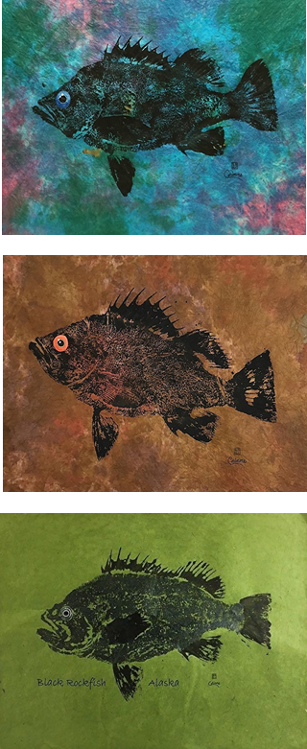
Accounting for population dynamics improves the use of no-take marine reserves for fishery management
Victoria Quennessen
MS Student in Fisheries Science
Hotel Coral y Marina, Ensenada, Mexico
Western Society of Naturalists
November 2nd, 2019

Slide 2
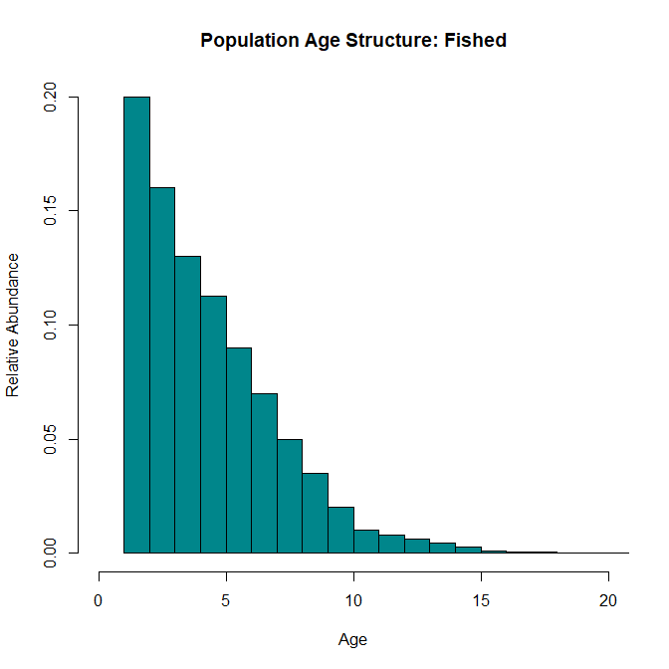
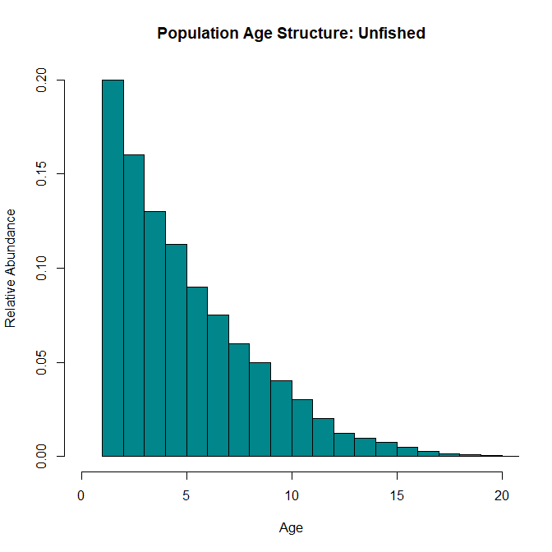
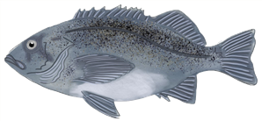
Effects of Fishing
Background
Methods
Results
Next Steps
Question
Conclusions
Bigger, older individuals
Notes:
Age structure naturally decreases as fish are fished, die from predation, cannibalism, lack of food, competition for habitat, etc…

Slide 3
Effects of Fishing
Background
Methods
Results
Next Steps
Question
Conclusions
Bigger, older individuals
Notes:
Effects of fishing (evenly across ages)
Truncation of age structure – since there are already less BOFFFFs, fishing disproportionately affects them
Decreased biomass and abundance
Increased vulnerability to fishing
Decreased resilience to environmental perturbations
Growing emphasis on use of marine protected areas (MPAs) to protect fisheries and reduce effects of fishing pressure
149 studies on 124 MPAs in 29 countries
As of 2015, 3.5% of world’s oceans in MPAs, about 1.6% strongly or fully protected (Lubchenco and Grorud-Colvert, 2015)

Slide 4
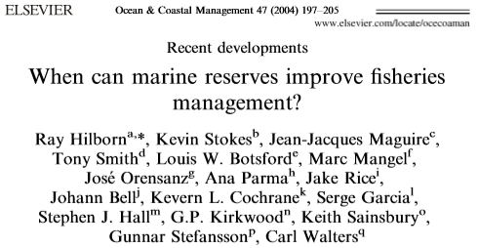
Effects of Fishing
Background
Methods
Results
Next Steps
Question
Conclusions
Bigger, older individuals
Notes:
Growing emphasis on use of marine protected areas (MPAs) to protect fisheries and reduce effects of fishing pressure
149 studies on 124 MPAs in 29 countries
As of 2015, 3.5% of world’s oceans in MPAs, about 1.6% strongly or fully protected (Lubchenco and Grorud-Colvert, 2015)
However, current research is still trying to evaluate how best to incorporate MPAs into fisheries management

Slide 5
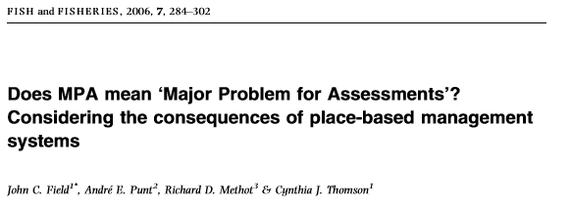
Effects of Fishing
Background
Methods
Results
Next Steps
Question
Conclusions
Bigger, older individuals
Notes:
Growing emphasis on use of marine protected areas (MPAs) to protect fisheries and reduce effects of fishing pressure
149 studies on 124 MPAs in 29 countries
As of 2015, 3.5% of world’s oceans in MPAs, about 1.6% strongly or fully protected (Lubchenco and Grorud-Colvert, 2015)
However, current research is still trying to evaluate how best to incorporate MPAs into fisheries management

Slide 6
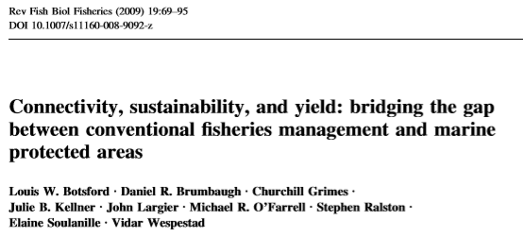
Effects of Fishing
Background
Methods
Results
Next Steps
Question
Conclusions
Bigger, older individuals
Notes:
Growing emphasis on use of marine protected areas (MPAs) to protect fisheries and reduce effects of fishing pressure
149 studies on 124 MPAs in 29 countries
As of 2015, 3.5% of world’s oceans in MPAs, about 1.6% strongly or fully protected (Lubchenco and Grorud-Colvert, 2015)
However, current research is still trying to evaluate how best to incorporate MPAs into fisheries management

Slide 7
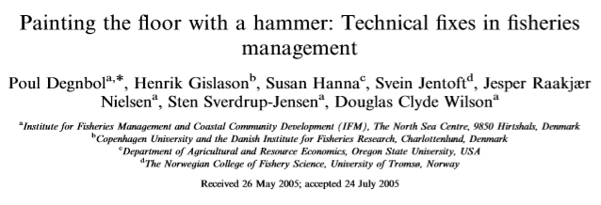
Effects of Fishing
Background
Methods
Results
Next Steps
Question
Conclusions
Bigger, older individuals
Notes:
Growing emphasis on use of marine protected areas (MPAs) to protect fisheries and reduce effects of fishing pressure
149 studies on 124 MPAs in 29 countries
As of 2015, 3.5% of world’s oceans in MPAs, about 1.6% strongly or fully protected (Lubchenco and Grorud-Colvert, 2015)
However, current research is still trying to evaluate how best to incorporate MPAs into fisheries management
When do MPAs help?
When do they complicate assessment and therefore management?
How can we bridge the gap?
And under what circumstances do they help the most, compared to other management techniques like Individual transferable quotas, community-based management, or combinations of them?

Slide 8
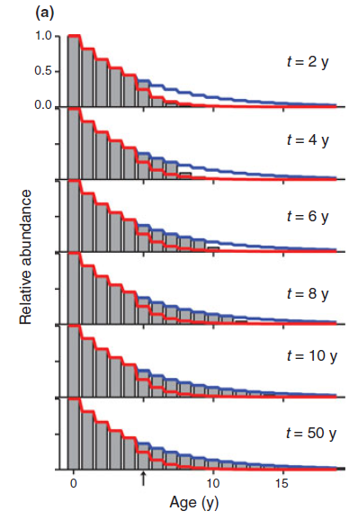
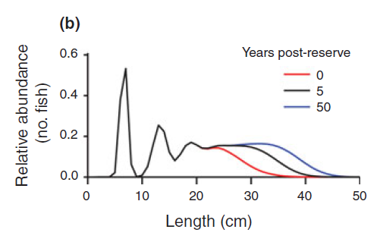
Background
Methods
Results
Next Steps
Question
Conclusions
Transient Dynamics
White et al., 2013
Notes:
Understanding transient dynamics can help us start to fill in this gap in knowledge
After protections, age structure fills back in over time (red line = fished, blue = unfished)
- The rate at which the age structure fills in and biomass increases depends on several life history characteristics, such as natural mortality rate
While the age structure fills back in, we get transient dynamics, which are different from the equilibrium dynamics that most fishery models use after reserve implementation
These transient dynamics amplify fluctuations in the population that could cause fishery managers to relax effort restrictions too soon

Slide 9
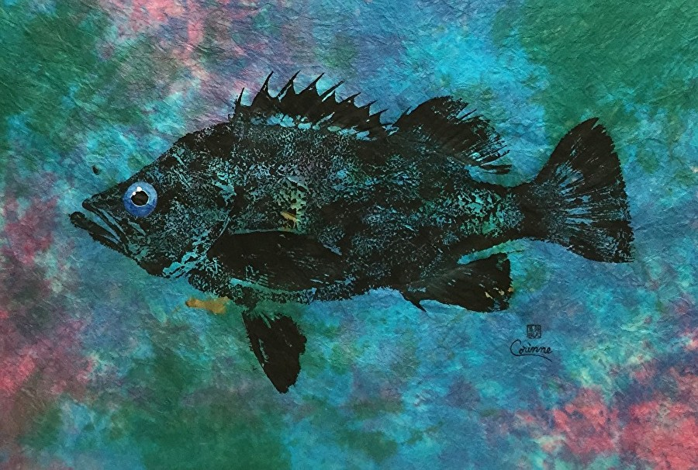
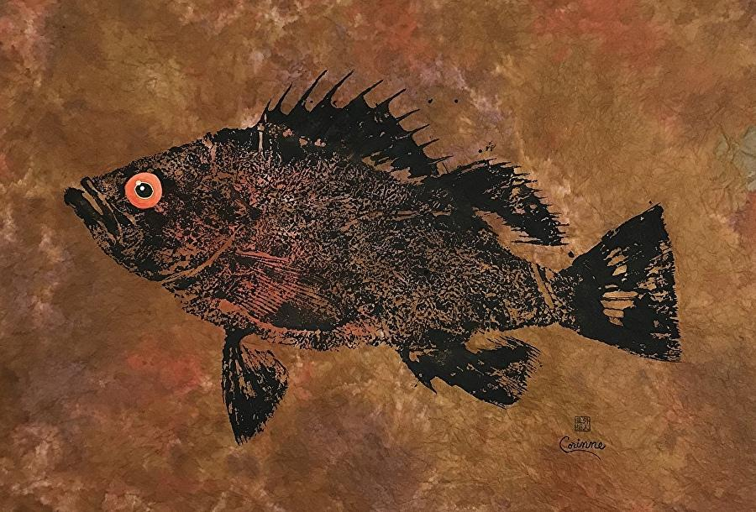
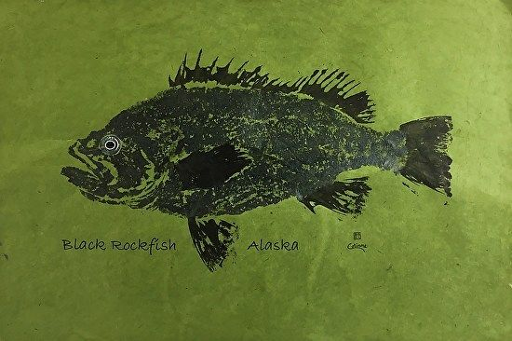
Background
Methods
Results
Next Steps
Question
Conclusions
Objectives / research questions
How can we best use information from within reserves to help manage fisheries following reserve implementation?
How does the inclusion of transient dynamics influence the short-term effect of control rules on yield and biomass?
What happens when we don’t have an accurate estimate of M for a fished species?

Slide 10
1. Replicate base model
Background
Methods
Results
Next Steps
Question
Conclusions
Population dynamics
Imperfect sampling
Current west coast groundfish fishery has 40:10 control rule
Density ratio as metric to assess level of depletion:
# ind./ area outside reserve
-------------------------------------
# ind./ area inside reserve
Management (control rules)
Fishing
Adapted from Babcock & MacCall 2011
Notes:
Fishing effort is reduced for stocks below a certain threshold (B40%, or 40% of unfished biomass) until it hits B10%, after which the fishery is closed completely
Translated from Visual Basic

Slide 11
2. Apply transient dynamics to control rules
Background
Methods
Results
Next Steps
Question
Conclusions
CR | 1 | 2 | 3 | 4 | 5 | 6
Type | Babcock & MacCall | Babcock & MacCall | Babcock & MacCall | Transient | Transient | Transient
M | Low | Correct | High | Low | Correct | High
Adapted from Babcock & MacCall 2011
$$Target DR=1 −\left(1 −Final DR\right)∗( e^{−Mt})$$
Adapted from White et al. 2013

Slide 12
Transient dynamics - yield
Background
Methods
Results
Next Steps
Question
Conclusions
Notes:
Define M and k

Slide 13
Transient dynamics - biomass
Background
Methods
Results
Next Steps
Question
Conclusions
Notes:
Define M and k

Slide 14

Next steps:
Background
Methods
Results
Next Steps
Question
Conclusions
Apply process to different species
Quantify effect of uncertainty about mortality on control rule success
Partner with ODFW to prep for 2023 OR marine reserve assessment
Notes:
Define M and k

Slide 15
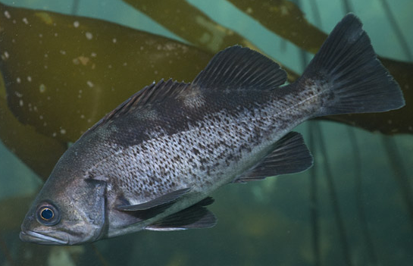
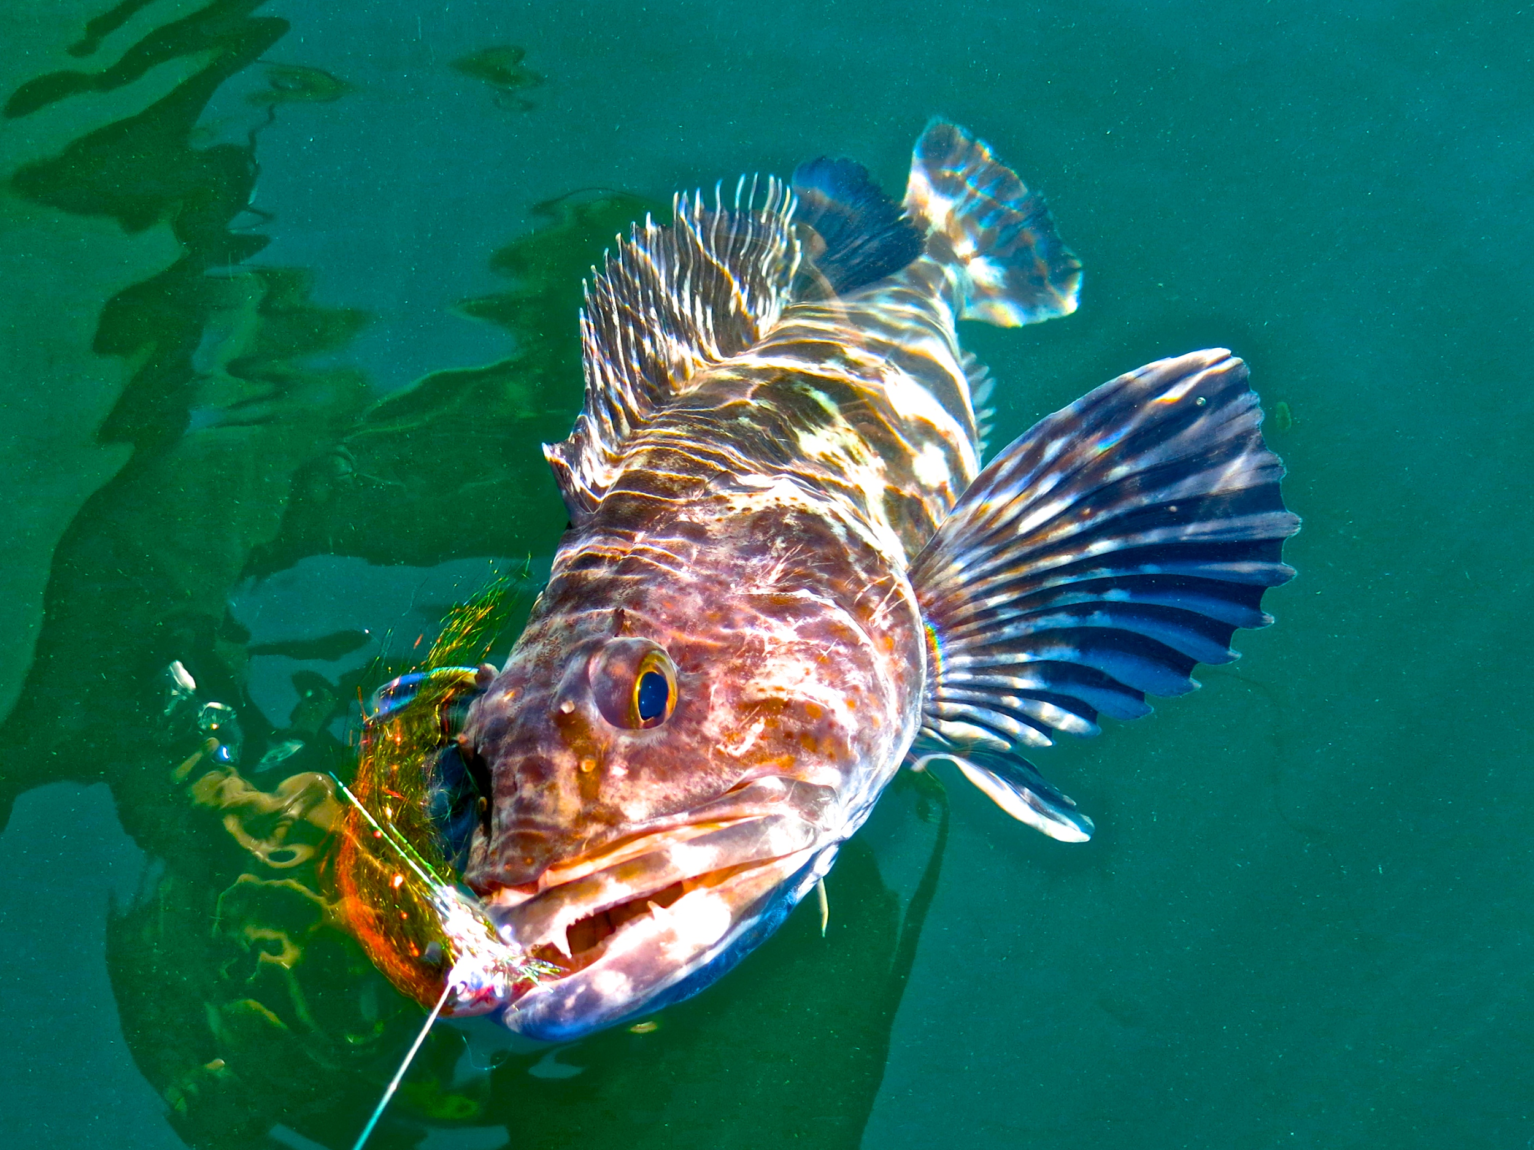
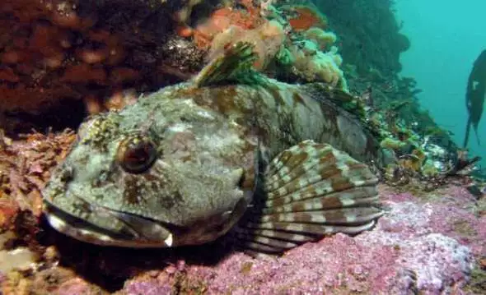
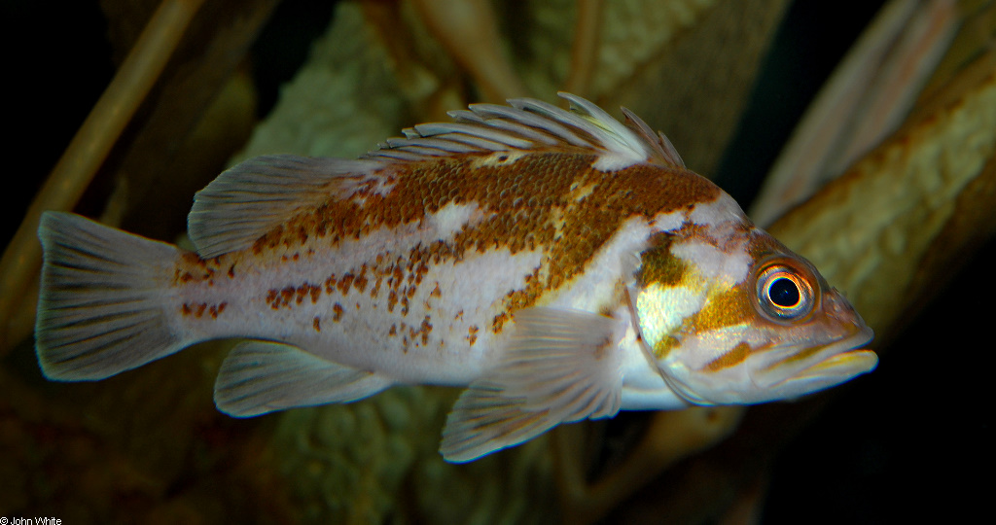
Background
Methods
Results
Next Steps
Question
Conclusions
Transient dynamics can help us to adaptively manage fisheries in and around marine reserves, and are more robust to inaccurate estimates of natural mortality, in terms of both yield and biomass.
Levi
Jay Nichols
FishWithJD
John White

